Slide 1
VARIATIONS IN PSYCHOLOGICAL ATTRIBUTES .
CLASS XII
CHAPTER ONE

Slide 2
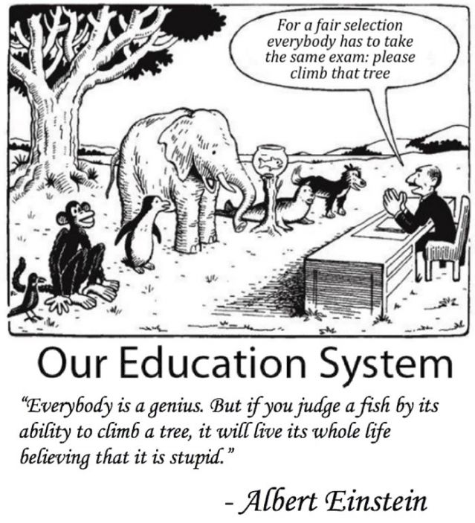
INTELLIGENCE

Slide 3
WHAT IS INTELLIGENCE ?
The ability to think abstractly
Plan
Gather information
Understand complex ideas
Solve problems
Reason
Adapt effectively to the environment
Overcome obstacles
Learn from experience
Adapt to a novel situation

Slide 4
INDIVIDUAL DIFFERENCE
Difference -: variations are common within and across all species (colour , nature , values, beliefs, interests, likes, attitudes ).
Variations are of two types- (i) physical
(ii) psychological
individual differences refers to distinctiveness and variations among peoples characteristics and behaviour patterns .
personal traits situational factors
influence’s behaviour

Slide 5
ASSESSMENT OF PSYCHOLOGICAL ATTRIBUTES
Psychological attributes - : reaction time , happiness, ( difficult to assess these psychological attributes )
Assessment is the first step in understanding these attributes
It refers to the measurement of psychological attributes and their evaluation by using multiple methods in terms of comparison.
It uses systematic testing procedures to evaluate abilities , behaviours , and personal qualities of individuals .
These assessments can be (i) formal (ii) informal

Slide 6
DOMAINS OF PSYCHOLOGICAL ATTRIBUTES
INTELLIG-ENCE
VALUES
INTEREST
PERSONA-LITY
APTITUDE

Slide 7
IMPORTANT ASSESSMENT METHODS
PSYCHOL-OGICAL TESTS
INTERVIEW
CASE STUDY
OBSERVATION
SELF REPORT

Slide 8
DEFINATIONS BY PSYCHOLOGISTS
Intelligence is the power of perceiving , learning , understanding and knowing .
ALFRED BINET : “ The ability to judge well , understand well , and reason well.”
DAVID WECHSLER : “It is the global capacity of an individual to think rationally ,act purposefully and to deal effectively with his / her environment”
GARDNER AND STERNBERG: “ An individual who is very intelligent not only adapts to the environment but also actively modifies or shapes it .”

Slide 9
PSYCHOMETRIC THEORIES OF INTELLIGENCE
UNI FACTOR THOERY
STUCTURE OF INTELLECT MODEL
TWO FACTOR THEORY
LEVEL I AND LEVEL II
THEORY OF PRIMARY MENTAL ABILITIES

Slide 10
INFORMATION PROCESSING APPROACH
PASS MODEL
TRIARCHIC THEORY
THEORY OF MULTIPLE INTELLEGENCE

Slide 11
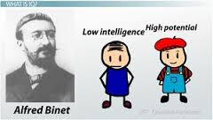
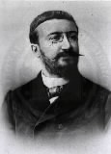
UNI / ONE FACTOR THEORY
ALFRED BINET
This theory shows interest in
differentiating between more
intelligent from less intelligent
individual .
He conceptualised intelligence
as consisting of one or more similar set
of abilities which can be used
in solving problems.
But later it was rejected as there were limitations .

Slide 12
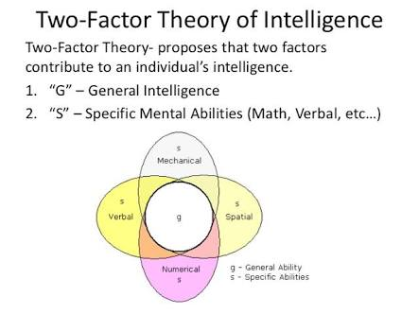
TWO –FACTOR THEORY
CHARLES SPEARMAN
Statistical method – factor analysis
Intelligence consisted of general factors ( G –factors ) and some specific factors (S- factors ).
General factors are mental operations
which are primary and common to
all example: singer , dancer etc
Specific factors or abilities which
are addition to these general factors ,
which make them different .

Slide 13
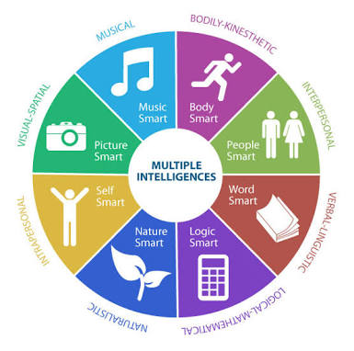
THEORY OF MULTIPLE INTELLIGENCE

Slide 14
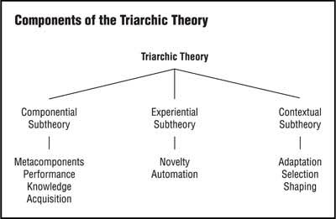
TRIARCHIC THEORY OF INTELLIGENCE

Slide 15
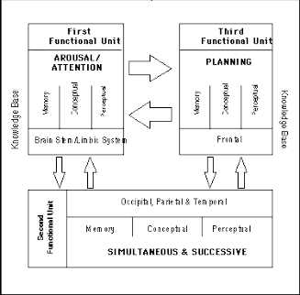
PASS MODEL OF INTELLIGENCE
JP DASS , JACK NAGLIERI, and KIRBY (1994)
Intellectual activity involves the interdependent functioning of three neurological systems called functional units of brain .
These units are responsible for –
* attention / arousal
* simultaneous and successive
processing
* planning

Slide 16
INTELLIGENCE IS THE INTERPLAY OF NATURE AND NURTURE
Schooling
Family background
Nourishment
Individual‘s intelligence is influenced by environment (nurture)

Slide 17
Nature influences intelligence
Hereditary influences on intelligence is evident from the studies on twin and adopted children .
Identical twins reared together | 0.90
Identical twins reared separately | 0.72
Brothers and sisters reared together | 0.50
Brothers and sisters reared separately | 0.25

Slide 18
ASSESSMENT OF INTELLIGENCE
In 1905 ALFRED BINET and THEODORE SIMON measured intelligence .
They gave the concept of MENTAL AGE (MA) i.e. intellectual development relative to people of his or her age group .
CHRONOLOGICAL AGE (CA) is the biological age from birth .
WILLIAM STERN devised a concept of IQ i.e. INTELLIGENCE QUOTIENT .
IQ refers to the mental age divided by chronological age and multiplied by 100.
IQ = MA / CA × 100

Slide 19
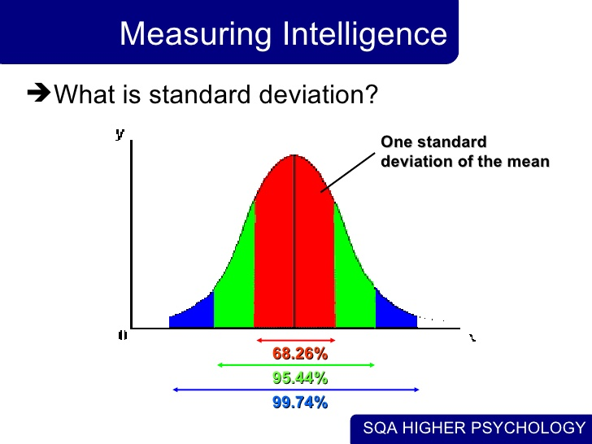

Slide 20
VARIATIONS OF INTELLIGENCE
INTELLECTUAL DEFICIENCY
children who face enormous difficulty in learning even simple skills and show intellectual deficiency are termed as MENTALLY CHALLENGED .
AAMD view retardation as “ significantly sub – average general intellectual functioning existing concurrently with deficits in adaptive behaviour and manifested during the developmental period ’’.
The different level of retardation are :
Mild retardation Moderate retardation Severe retardation Profound retardation

Slide 21
INTELLECTUALLY GIFTTED INDIVIDUALS
INDIVIDUAL
SUPERIOR GENERALIZATION AND DISCRIMINATION
CREATIVE THINKING
INDEPENDENT , NON CONFORMIST
GOOD COGNITIVE ABILITY

Slide 22
TYPES OF INTELLIGENCE TEST
INDIVIDUAL AND GROUP TEST
VERBAL , NON VERBAL AND PERFORMANCE TEST
CULTURAL FAIR AND CULTURAL BIASED TEST

Slide 23
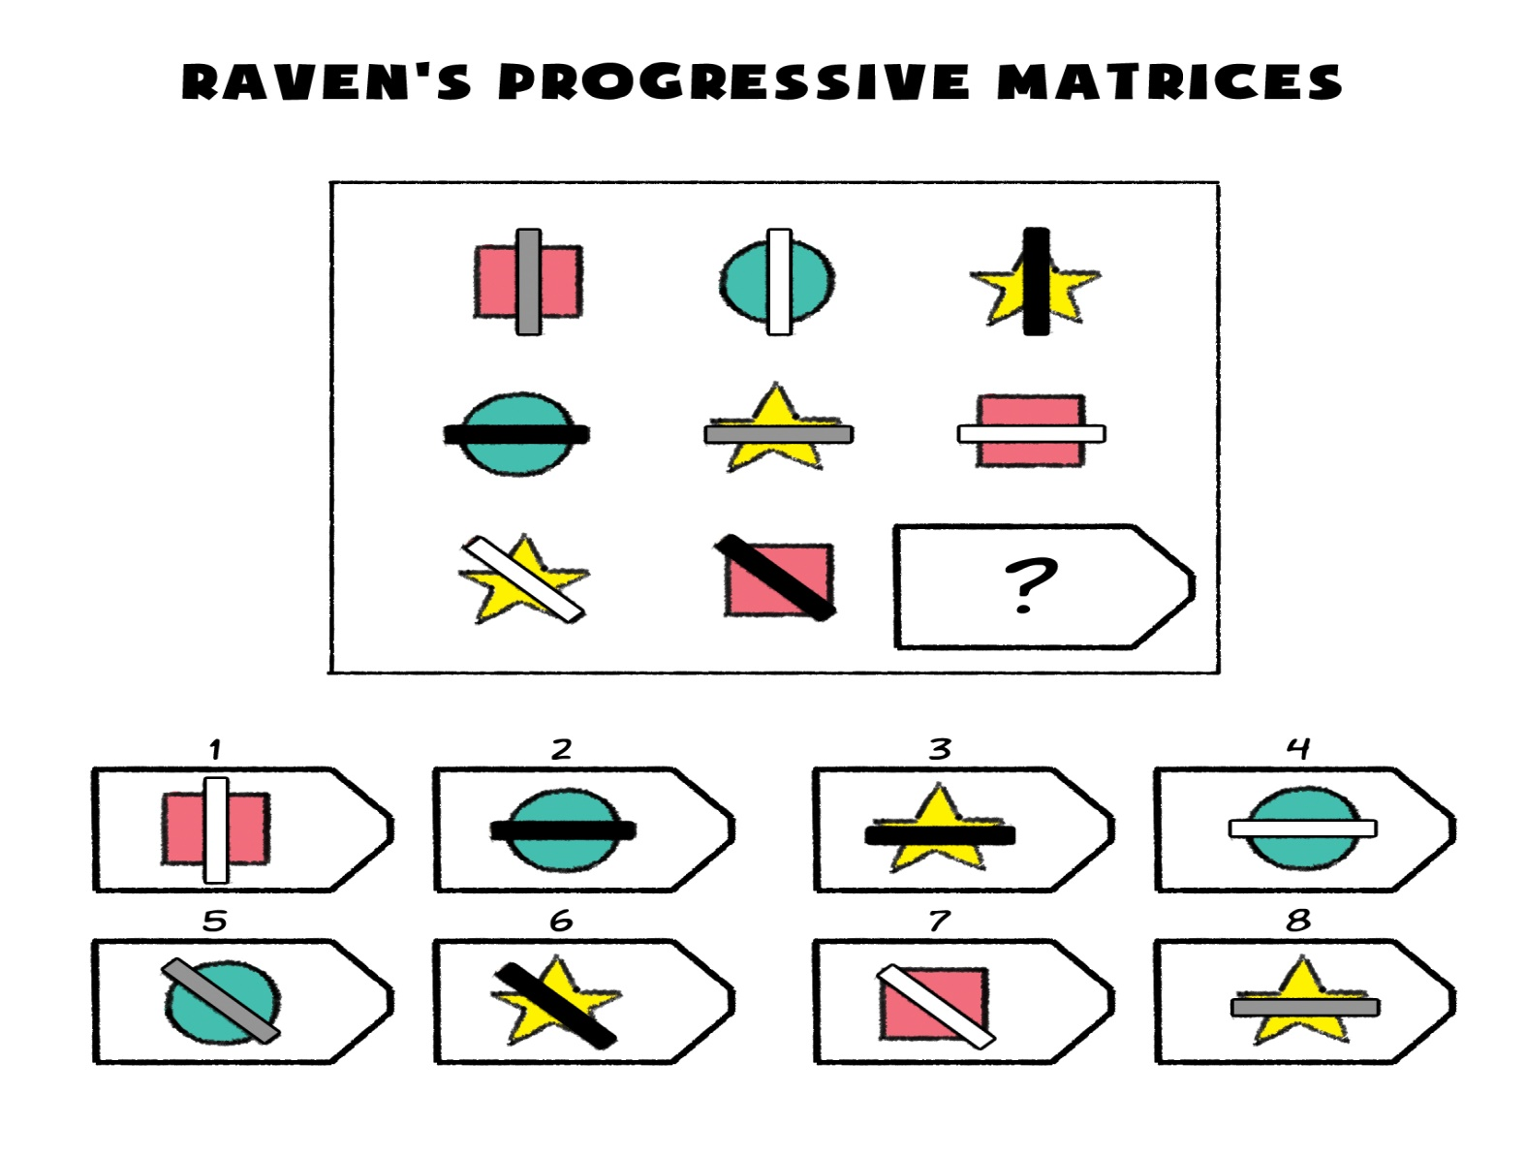
NON VERBAL TEST

Slide 24
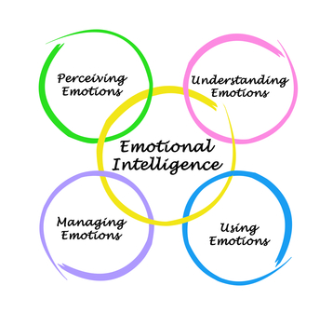

Slide 25
CULTURE AND INTELLIGENCE
Intelligence help the individual to adapt their environment
Culture is a collective system of customs , beliefs, attitudes and achievement in art and literature.
INTELLIGENCE IS THE PRODUCT OF CULTURE.

Slide 26
DIFFERENCE BETWEEN APTITUDE AND INTERESTS
APTITUDE INTEREST
Special abilities or * preference for particular
specific skills in a activity .
particular field of activity .
acquire after training * may be influenced

Slide 27
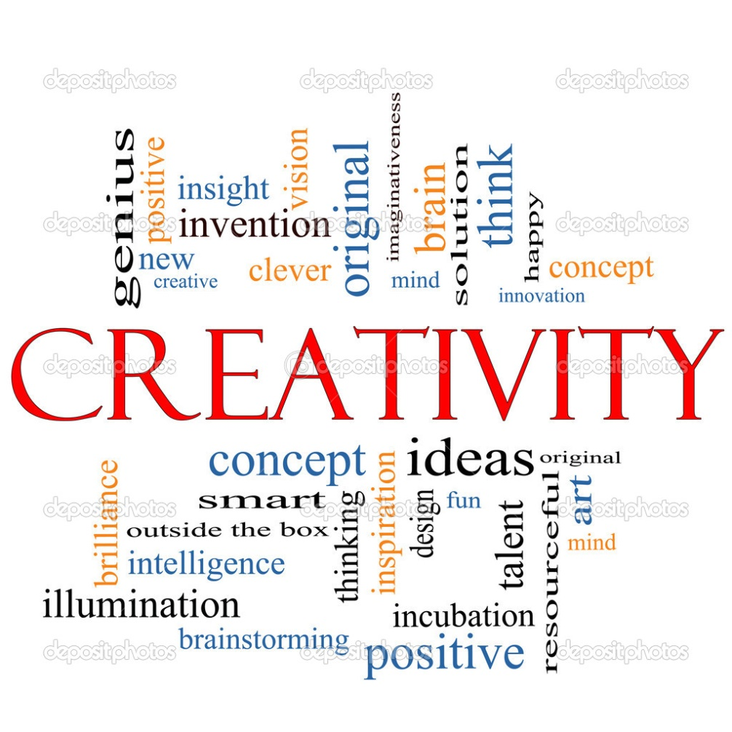
CREATIVITY

Slide 28
CREATIVITY AND INTELLIGENCE
A person who has the ability to learn faster and reproduce accurately may be considered intelligent more than creative unless s/he devises new way of learning .
Terman (1920) found that persons with higher IQ were not necessarily creative .
Creative ideas can come from person who did not have a very higher IQ.
INTELLIGENT-----
CREATIVE

Slide 29
CHARACTERISTICS OF CREATIVITY TEST
OPEN ENDED
ALLOW TO THINK DIFFERENTLY
NO SPECIFIC ANSWER
FREEDOM TO USE IMAGINATION
DIVERGENT THINKING

Slide 30
THANK YOU ………

